Slide 1





STOCK MARKET FORECAST
Team : BALACHANDRAN M
Email : Balachandran.m06@gmail.com
Guide: (P.Raja, Master Trainer )
Disclaimer: The content is curated for educational purposes only.
Notes:
Slides: Prepare a short slide deck (10-12 slides) summarizing the project objectives, methodology, and key results.

Slide 2
OUTLINE
Abstract
Problem Statement
Proposed System/Solution
Algorithm & Deployment
GitHub Link
Project Demo(photos / videos)
Conclusion
Future Scope
References

Slide 3
Abstract
Sentiment analysis, also known as opinion mining, involves using AI and natural language processing to identify and measure emotions in text. It counts positive and negative words to determine if the sentiment is positive, negative, or neutral. Key types include emotion-based, fine-grained, and aspect-based sentiment analysis, all focused on understanding the overall tone (polarity) of a message. With AI and machine learning, companies can quickly analyze large amounts of text—like emails, chat transcripts, social media, and reviews—to get insights on public sentiment and improve customer understanding.

Slide 4
Problem Statement
Interpreting the meaning of words in different contexts. AI often struggles with analyzing different sentiments, such as sarcasm or negation, or sentences with multiple sentiments. This makes it challenging to categorize text as positive, negative, or neutral.

Slide 5
Proposed Solution
To implement sentiment analysis, first collect and clean text data, removing any irrelevant elements. Next, break down the text into individual words and count positive and negative terms using a sentiment lexicon like VADER or TextBlob, which can assign sentiment scores. These scores indicate if the text is positive, negative, or neutral. For greater accuracy, a machine learning model can be trained to capture more nuanced sentiment. Finally, visualize the results to observe trends and insights, updating the lexicon or model periodically to ensure relevance. This process enables quick analysis of large datasets, revealing valuable insights about audience sentiment.

Slide 6
Github project link
https://github.com/Balachandranmurugan/Naan-Mudhalvan-Project.git
Notes:
thank you very much for joining this PPT, keep learning.
6

Slide 7
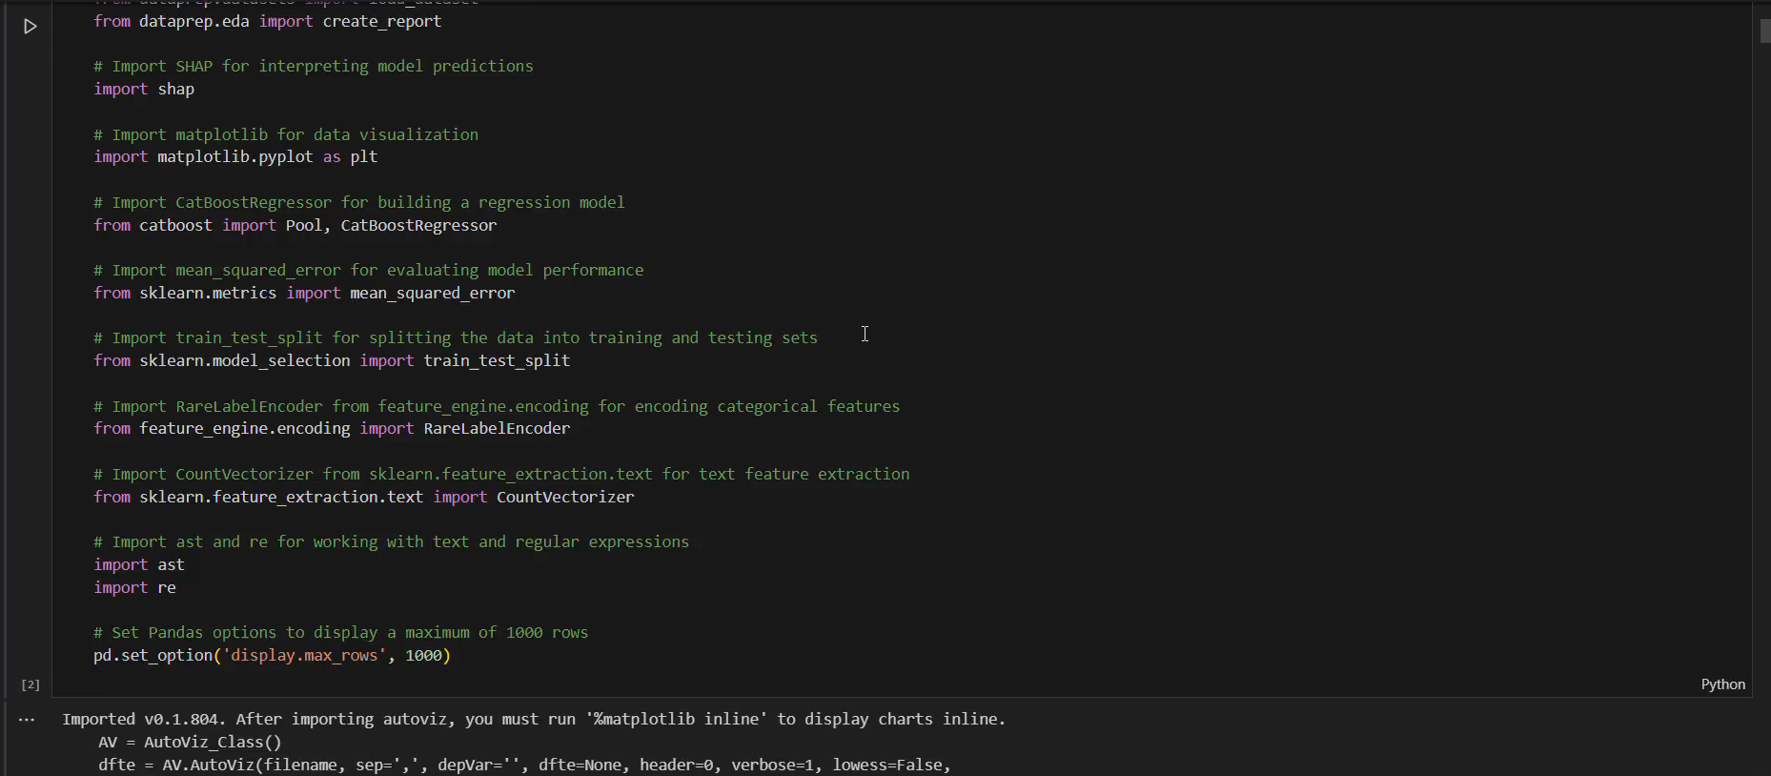
Video of Project Demo

Slide 8
Conclusion
In conclusion, sentiment analysis provides a powerful tool for understanding audience emotions and feedback by efficiently analyzing large volumes of text data. Using a combination of lexicons and machine learning models enhances accuracy, allowing businesses to gain real-time insights into customer sentiment. This analysis can guide strategic decisions, improve customer satisfaction, and foster better communication by identifying and addressing trends in audience sentiment.

Slide 9
Future Scope
Real-time
adaptive
multilingual
predictive
scalable

Slide 10
Thank you!
Notes:
thank you very much for joining this PPT, keep learning.
10

